Slide 1
Release Management Phase 1 Assessment Context
27/01/2015

Slide 2
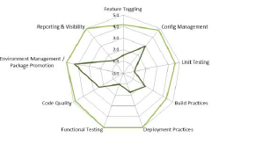
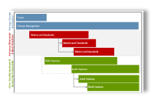
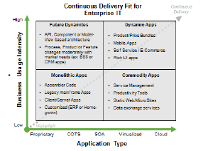
Context & Scope
The client wants to improve control of software releases and better understanding the composition of a release in terms of both its technical and functional components. Further, there is a desire to increase IT agility.
Both of these aspects of IT delivery can be addressed by improving capabilities around development architecture.
With the client’s support Accenture will be undertaking a rapid (two week time-bound) assessment of Development Architecture / DevOps capabilities around the Store application for Release and Configuration Management. This will produce an assessment of capabilities, identify gaps against best practice, prioritise these and propose a high-level roadmap to improve capabilities. The Roadmap will require further analysis following this initial work in order to estimate and properly plan it.
Capability Assessment Prioritisation Model Roadmap
The benefit of this work will be an agreed roadmap which can form the basis for next step capability improvement task estimating and detailed planning.

Slide 3
Approach
The approach for this phase of work is to perform a rapid assessment of the ‘As-Is’ development architecture capability as used for the Store application development project.
The following Stakeholders will be consulted during this phase:
Stakeholder | Role
Accenture has Development Architecture/Dev Ops Maturity Model assets to support this type of client request, however, for this rapid initial phase more informal interviews will be held using these assets to guide questioning in order to reach a judgement of the ‘as-is’ capabilities of the clients processes and tools supporting:
Software Configuration Management
Configuration & Tokenisation
Software Build and Release process
The expected deliverables from this phase will be:

Slide 4
Approach (cont)
The approach for this phase of work is to perform a rapid assessment of the ‘As-Is’ development architecture capability as used for the Store application development project.
The assessment will cover the following development architecture areas, with the primary focus areas highlighted in red.
Configuration Management
Management Plan;
Branching & Merging;
Labelling & Promotion;
Tools & Administration;
Defect Process.
Environment Management
Support Process;
Release Lifecycle;
Environment Management;
Environment Monitoring.
Engagement Model
Configuration Management
Development
Test Execution
Environment Management
Development
Development Process;
Source Control;
Environment Requirements;
Build Process;
Fix Process.
Engagement Model
Organisational Structure;
Responsibilities;
Control;
Measurement;
Reporting.
Test Execution
Test Approach;
Test Execution;
Defect Management;
Reporting.

Slide 5
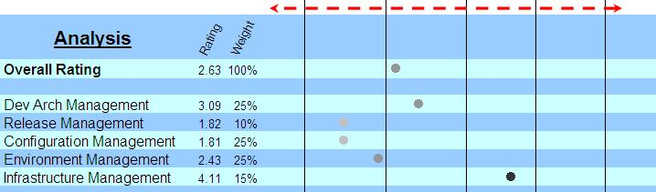
Expected Outcomes
The analysis will enable the following aspects to be assessed against best practice. The gap will help identify prioritised work items to be addressed.
Immature/Uncontrolled
Mature/Controlled/Repeatable
Example
The list below is a straw-man of possible outcomes of areas to address that will be updated / validated during the analysis process:
Full automation from developer check-in to build, test and deployment to all environments. This will invariably require automated configuration and environment tokenisation.
Automated environment smoke-tests to confirm automated environment deployments were successful
Improved change control processes such that all code is labelled with the reason for change.
Revised branch and merge strategy to support finder grained control of release composition.
Environments dashboard – to better represent the status of environments and releases deployed to them.
Automated environment diagram production.
The adoption of a DevOps culture to facilitate better collaboration between software developers and IT Operations – this will not appear as a planned roadmap task though as it a higher-level operating model concern.
There prioritised items will be put into a high-level roadmap, which will need further analysis in order to come up with estimates and delivery plans etc.

Slide 6
Expected Outcomes
Introductions
Involvement with Development Architecture Processes
Current Pain-Points
Constraints
Impact to business of Key Issues
Detailed questions to drive the assessment of Release & Configuration Management capabilities
Development
Build
Configuration
Environments
Deployment
Testing

Slide 7
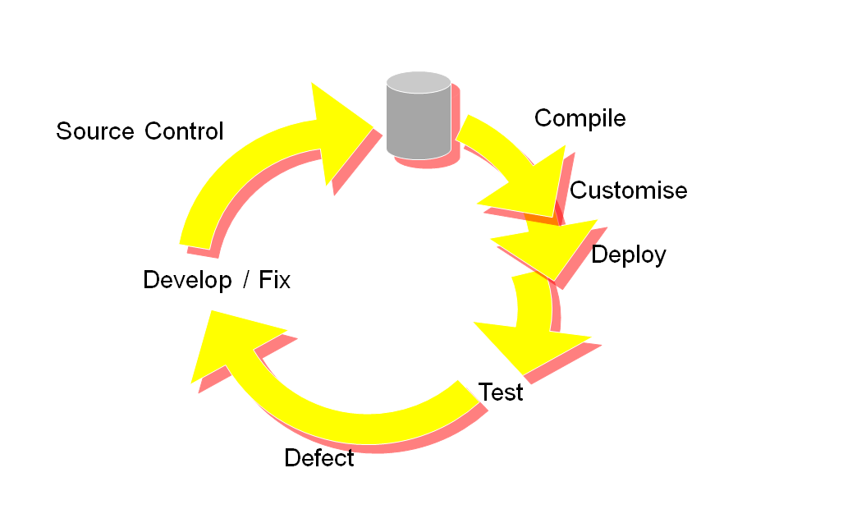
Lifecycle Model – for discussion

